Slide 1
Determining Movie Success by analyzing Tweet Sentiments
By: Ankit Luv Mittal
Ajinkya Bobade
1

Slide 2
Problem Statement
The purpose of this project is to determine if there’s a correlation between the sentiment towards the movie on Twitter and its eventual user rating on IMDB after its release.
Key Hypothesis: Movies with an IMDB user rating higher than 8 is expected to have an overall positive sentiment rating and good financial success.
Similarly, movies with a rating below 7 will have an overall negative sentiment and go into losses.
2

Slide 3
Movie Selection
We picked 5 movies that released within the last few months:
Barbershop: The Next Cut
Captain America: Civil War
Jack Reacher
Doctor Strange
Moana
We chose the first 4 movies (that have already released) to first check if there’s actually a correlation, and we chose the last movie to predict its user rating based on the sentiment.
3

Slide 4
Approach
Load and run sentiment_mod_builder.py followed by sentiment_mod.py code to create pickle files.
Use twittersemantics.py and change the names in it for finding hashtag to each movie one by one and run it.
Execute All Ratings Plot.py to plot the graph with taking movieName.txt files as input.

Slide 5
NLTK
NLTK Library used to identify sentiments from tweets
Two sentiment files - Positive and Negative
These two files served as our sentiment dictionaries
Using scikit-learn to get the confidence
Average Accuracy: 66%
5
Notes:
https://pythonprogramming.net/static/downloads/short_reviews/positive.txt
https://pythonprogramming.net/static/downloads/short_reviews/negative.txt

Slide 6
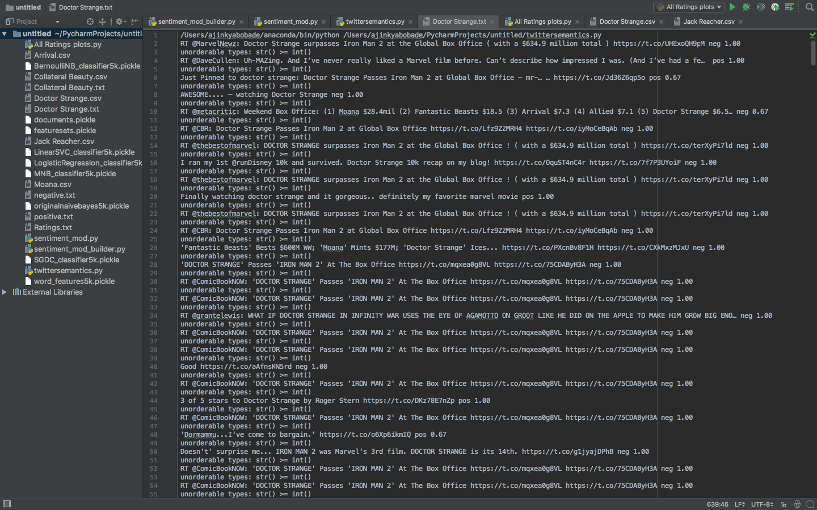
Database - Live Tweets
Using pickle files, live tweeting was done faster
Served as our database for tweets
6

Slide 7
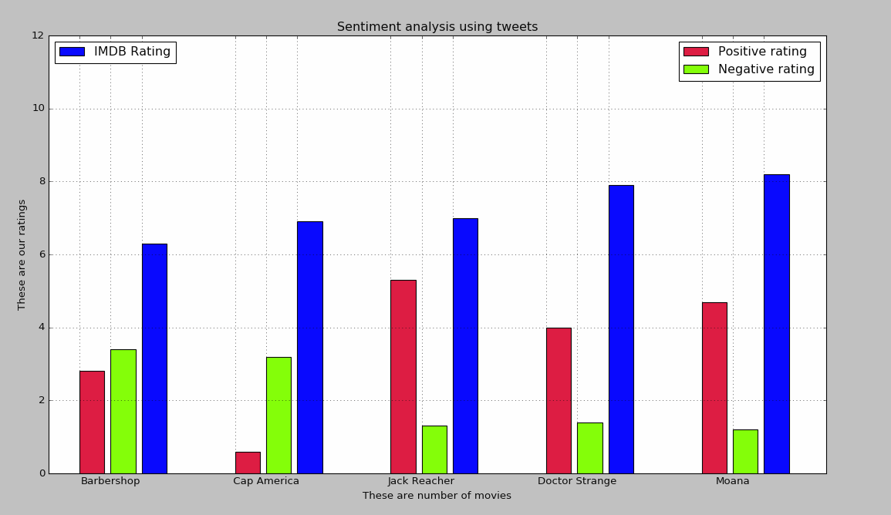
Graph
7

Slide 8



Final Outcome
Movies (Sorted by their release date) | Average Sentiment (Pos / Neg) | IMDB User Rating | Our Prediction Based on Sentiment | Was it a correct prediction? | Accuracy
Barbershop: The Next Cut | 2.8 / 3.5 | 6.3 | Unsuccessful | YES
Captain America: Civil War | 0.8 / 3.3 | 6.8 | Unsuccessful | YES
Jack Reacher | 5.3 / 1.4 | 6.9 | Successful | No
Doctor Strange | 4.0/1.5 | 7.9 | Successful | YES
Moana | 4.6/1.3 | 8.2 | Successful | Predicted
8

Slide 9
Conclusion
The people who tweet about movies are mostly the same people who rate and influence the movie ratings.
Good amount of correlation between the sentiment about a movie through tweets and it’s eventual success.

Slide 10
CHALLENGES
The challenge was to pick a relevant movie where we could get enough data for our tweet database.
Movies with same name creates ambiguity.

Slide 11
References
http://scikit-learn.org/stable/tutorial/machine_learning_map/
https://pythonprogramming.net/naive-bayes-classifier-nltk-tutorial/
https://pythonprogramming.net/sklearn-scikit-learn-nltk-tutorial/
https://pythonprogramming.net/python-pickle-module-save-objects-serialization/
11

